Slide 1
Basic Configuration

Slide 2
Module Overview
In this Module, we will understand the following:
Overview of Hibernate
Architecture
Environment Setup
Configuration
Sessions

Slide 3
Introduction to Hibernate
Hibernate is an Object-Relational Mapping (ORM) option for JAVA. It is created by Gavin King in 2001. It is an open source persistent framework and a powerful, high performance Object-Relational Persistence and Query service for any Java Application.
Hibernate itself maps Java classes to database tables and from Java to SQL data types .This relieves the developer from majority of common data persistence related programming tasks.
Hibernate falls between traditional Java objects & database server to handle all the tasks in persisting those objects based on the appropriate O/R mechanisms and patterns.
The ORM Framework simplifies to store data from object instance in memory to persistent data store and load them back into same object structure.
It is also JPA provider which implement mapping of JAVA objects to relational database.

Slide 4
Introduction to Hibernate Cont..
Benefits of using Hibernate:
Hibernate takes care of mapping Java classes to database tables using XML files This is possible without writing any line of code.
It does not require an application server to operate.
Developers are provided with simple APIs for storing and retrieving Java objects directly to and from the database.
In case of database change, then only the XML file properties needs to be updated.
It provides a way to work around familiar Java Objects.
Manipulates Complex associations of objects of your database.
Minimizes database access with smart fetching strategies.
Provides simple querying of data.
Supported Databases
Hibernate supports almost all the major RDBMS. Following is a list of few of the database engines supported by Hibernate −
HSQL Database Engine
DB2/NT
MySQL
PostgreSQL
FrontBase
Oracle
Microsoft SQL Server Database
Sybase SQL Server
Informix Dynamic Server
Supported Technologies
Hibernate supports a variety of other technologies, including −
XDoclet Spring
J2EE
Eclipse plug-ins
Maven

Slide 5
Architecture
There are Three Objects:
Connection Manager
Transaction Manager
ORM
Application
POJO Object
Persistence Object
Hibernate is provide configuration between data and persistent services.
It Require data in table format in database and map that data using instance variable in Class.
Hibernate perform Query Operation of Insert,Update,Delete.
Hibernate properties
XML Mapping
Database
Store details of SQL queries from object
Fast development in application and easy code generation
Easy to Transaction management
Use of automatic key generation
Based on JDBC Concept.
No need to deal with the database implementation.
Notes:
Connection Management: It provide management of database and require resources of open and close database connection.
Transaction Management: This service provide the ability to execute database statement more than one time.
Object Relational Mapping : It represent data of relational model and data model. Use Session.save() to read data.

Slide 6
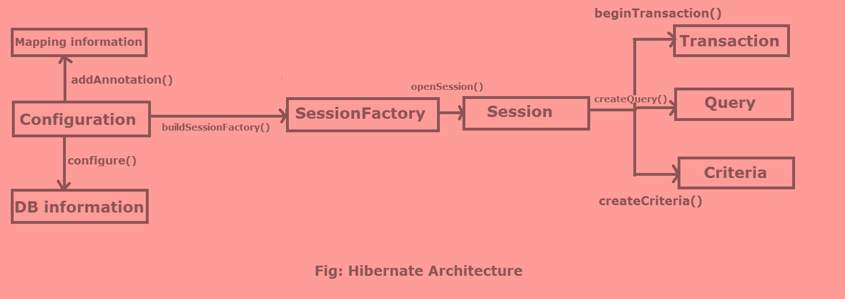
Architecture
Configuration Class:
Read configuration files and Mapping Files.
Session Factory:
Is an interface that used to create Session Object.
Session:
Used to open and close connection based on Session Factory Interface.
Notes:
Configuration:
Configuration is a class which is present in org.hibernate.cfg package. It activates Hibernate framework.
It checks whether the config file is syntactically correct or not.
If the config file is invalid, an exception is thrown. If it is valid then it creates a meta-data in memory and returns the meta-data to object to represent the config file.
Syntax:
It activate Hibernate Framework
Configuration cfg=new Configuration();
It read both cfg file and mapping files
cfg.configure();
Session Factory:
It is immutable and thread-safe in nature.
Session Factory factory=cfg.buildSessionFactory();
Session:
It is a light-weight object used to perform CRUD operations.
Syntax:
Session session=factory.buildSession();
Transaction:
Transaction object is used to give necessary instruction to the database to make the changes as per various operation by using commit() method.
Syntax:
Transaction tx=session.beginTransaction();
tx.commit();
Query:
Query is an interface that present inside org.hibernate package.
A Query instance is obtained by calling Session.createQuery().
Syntax:
Query query=session.createQuery();
Criteria:
The Session is a factory for Criteria. Criterion instances are usually obtained via the factory methods on Restrictions.
Criteria criteria=session.createCriteria();

Slide 7
Environment Setup
SETUP Environment For Hibernate As Below:
Window 10
Java version 7
Eclipse Latest version and install in your machine.
Hibernate3 Latest Version.
MySQL database Latest version.
JConnector (MySQL Database Driver)

Slide 8
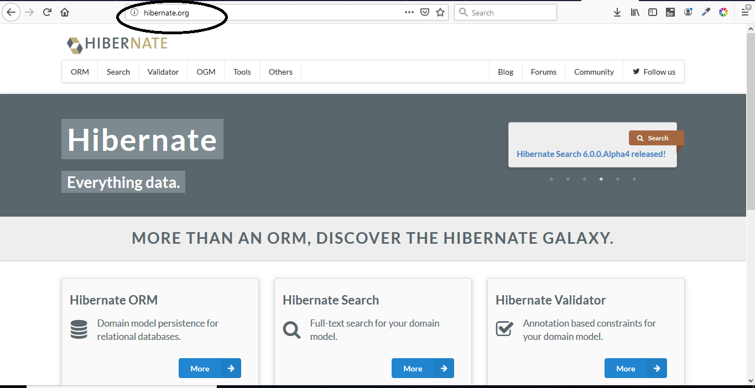
Environment Setup Duration 10Min
Step:1
For Using Hibernate Go To Hibernate site and Download Latest Version Of All JAR Files of Hibernate.
www.hibernate.org.
Click on More in Hibernate ORM
Notes:
This Link Generate Latest JAR Files Of Hibernate

Slide 9
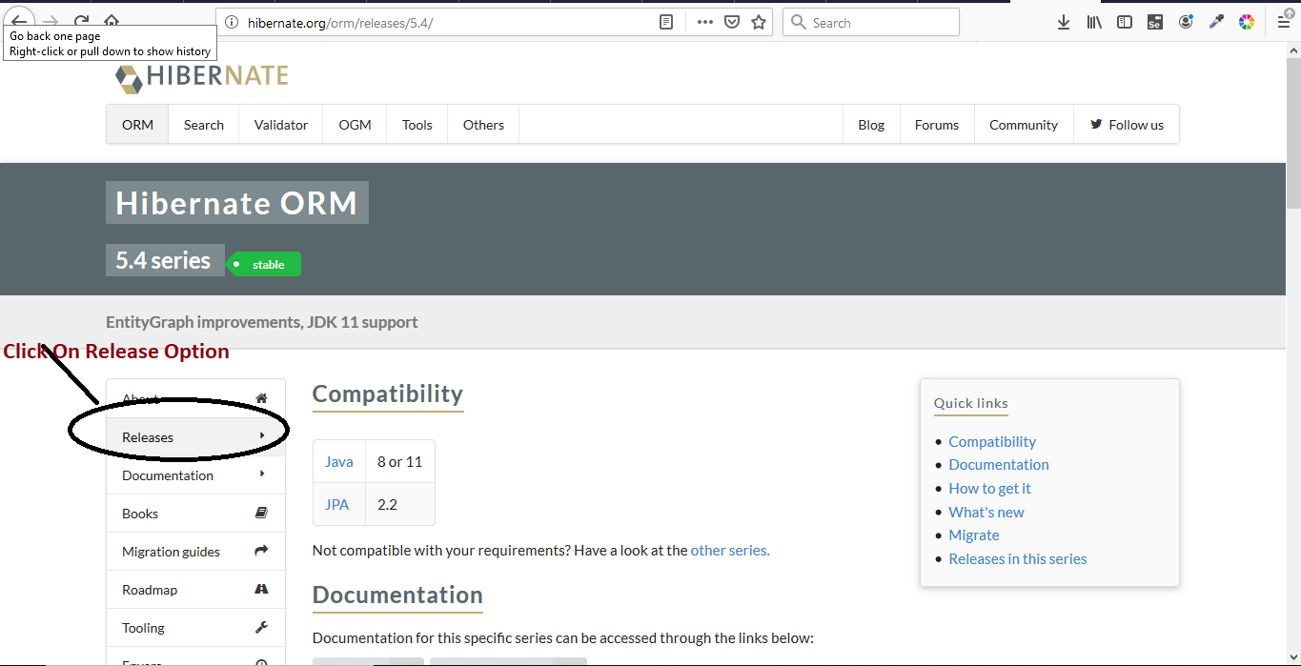
Environment Setup Cont..
Step:2
Click On Release Button and Show Latest Repository Of Hibernate.
Scroll down and Select the release download.

Slide 10
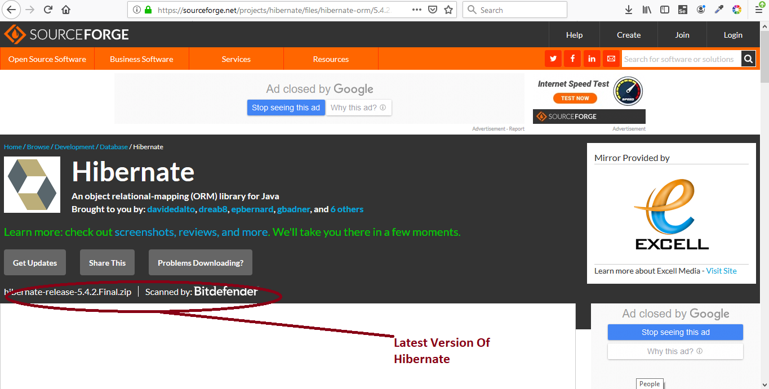
Environment Setup Cont..
Step:3
Click On Latest Version Of Repository

Slide 11
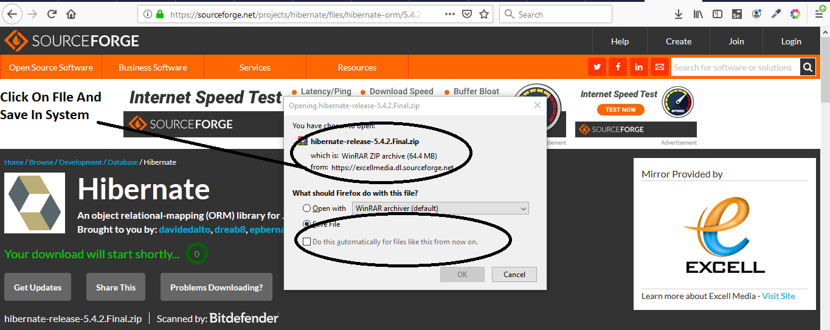
Environment Setup Cont..
Step:4
Save Repository In Particular Destination In Your System.

Slide 12
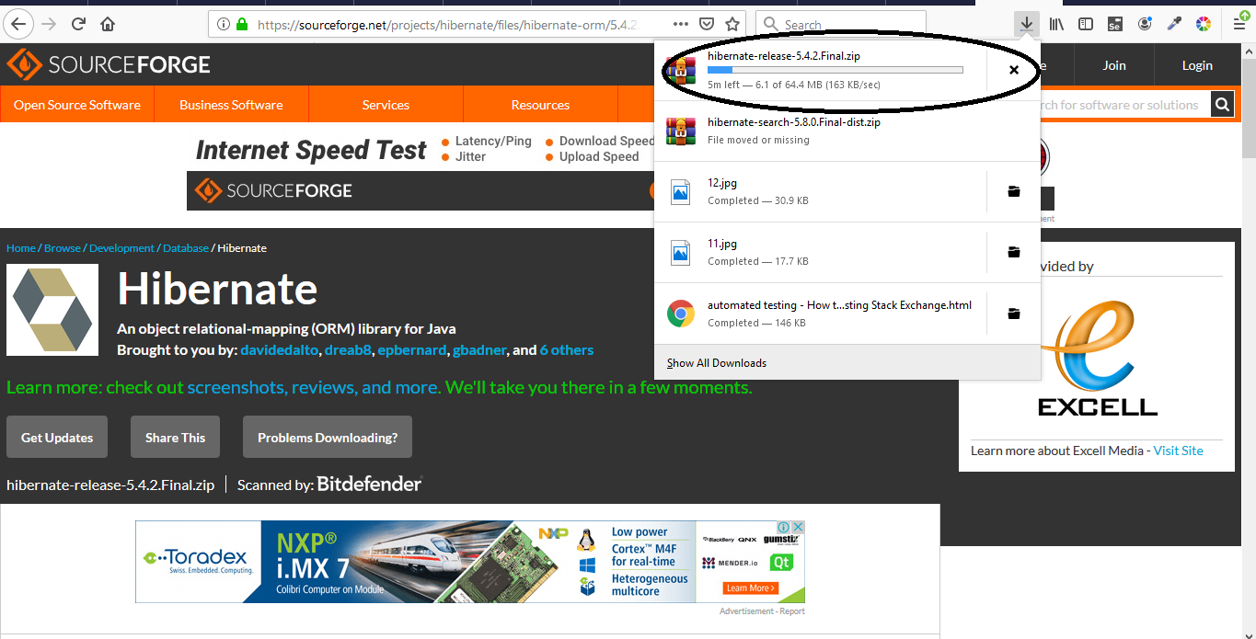
Environment Setup Cont..
Step:5
Start Downloading Of Repository. You Can See Downloading.

Slide 13
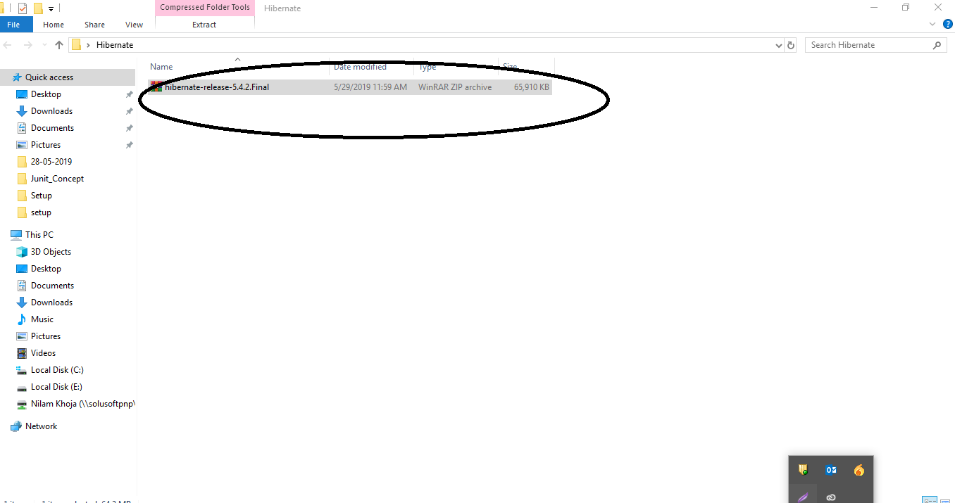
Environment Setup Cont..
Step 6:
You Can Save Repository In Particular Destination.

Slide 14
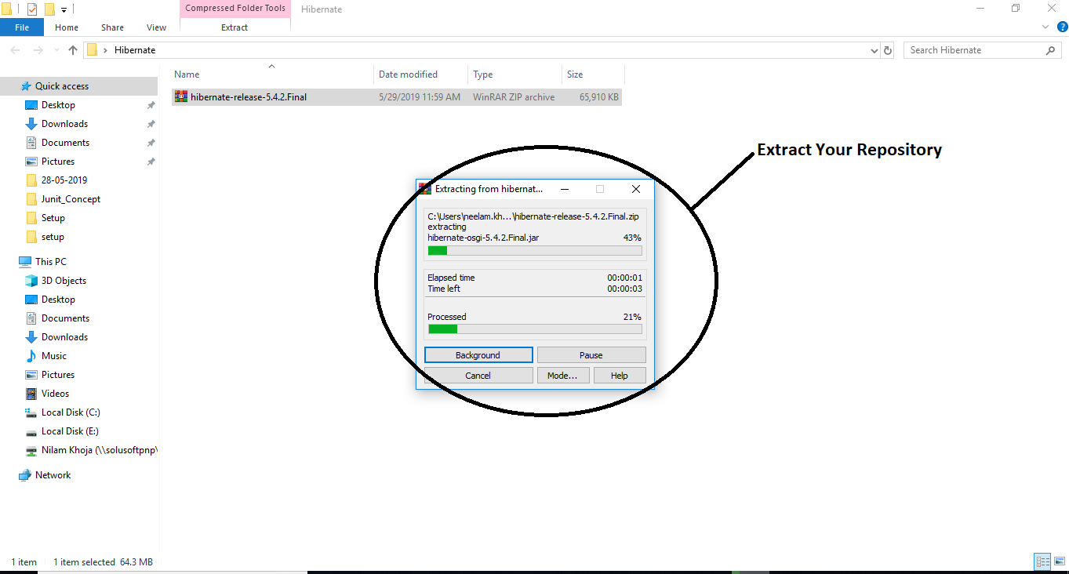
Environment Setup Cont..
Step 7:
Extract Repository On Same Location

Slide 15
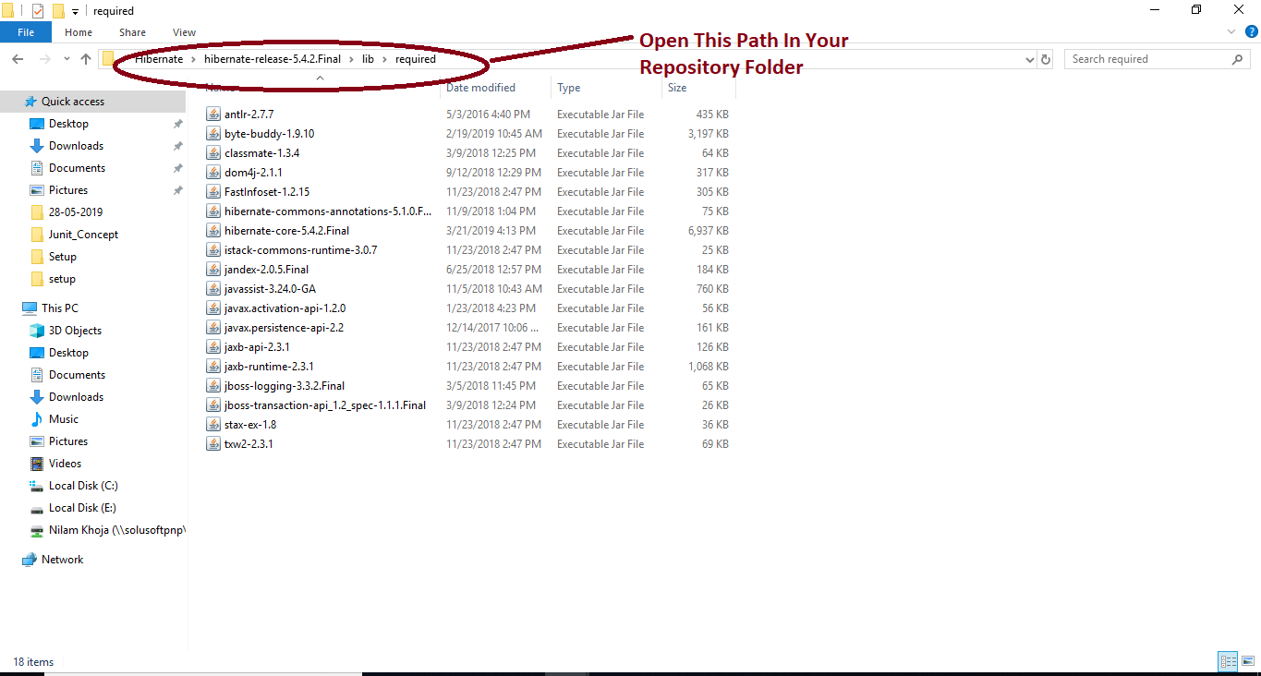
Environment Setup Cont..
Step 8:
After Extract, the Repository Open lib Folder in Required Folder Of Repository.
Show All Libraries Of Hibernate.
Notes:
In Repository Show All JAR files which you have to build in your JAVA Hibernate Project.

Slide 16
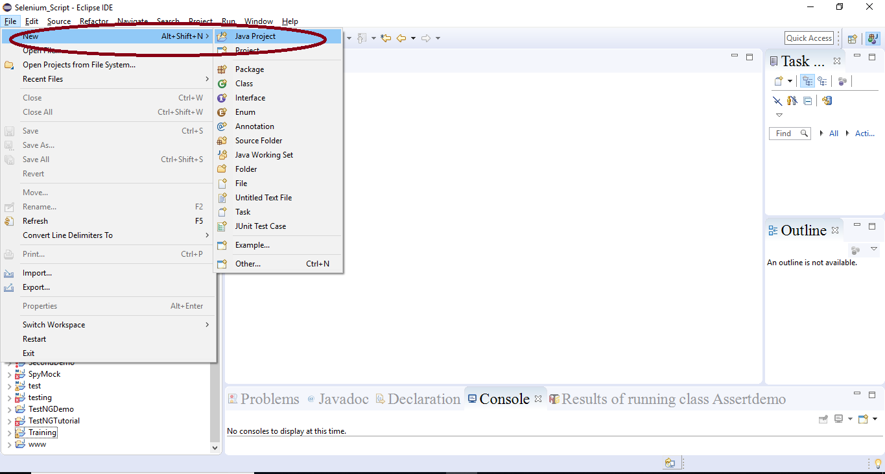
Demo: Configuration Duration 15 Min
Step :1
Create New Java Project

Slide 17
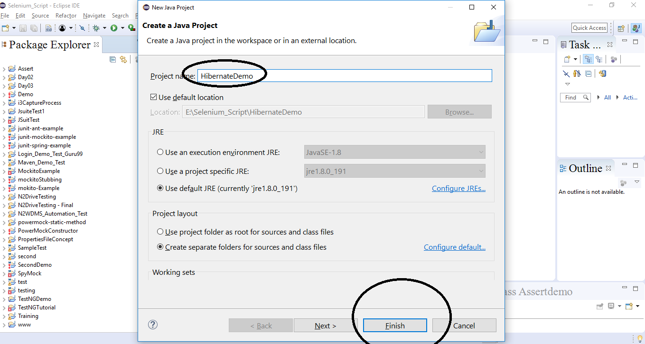
Demo: Configuration Cont..
Step :2
Give Proper JAVA Project Name And Click On Finish Button

Slide 18
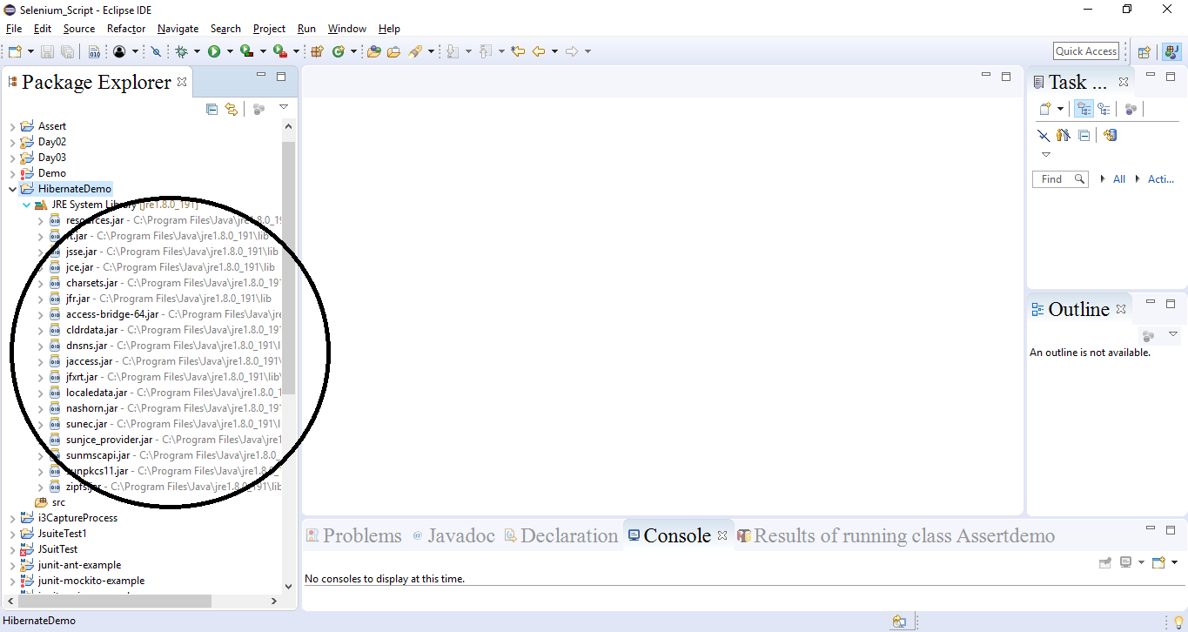
Demo: Configuration Cont..
Step :3
You Can See Project Structure Only With JRE Files.

Slide 19
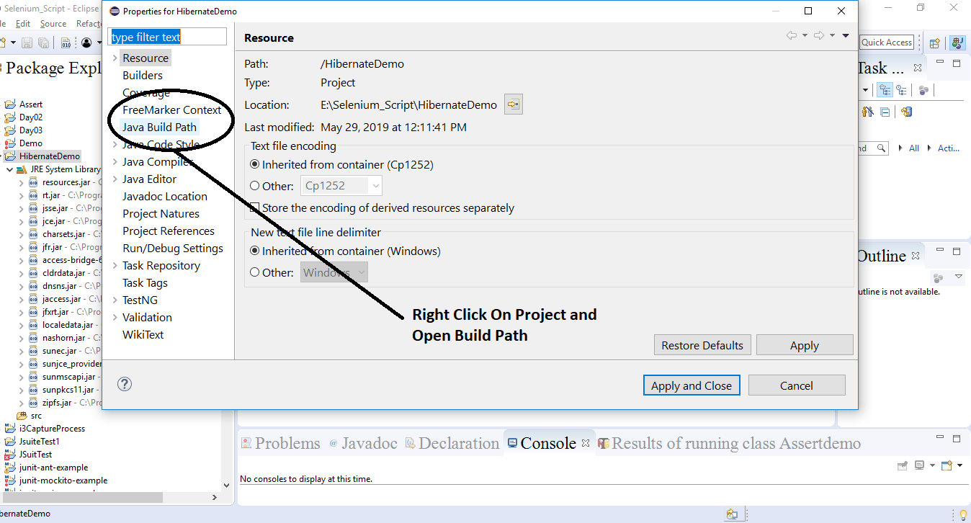
Demo: Configuration Cont..
Step :4
Now Add Hibernate JAR Files From JAVA BUILD PATH

Slide 20
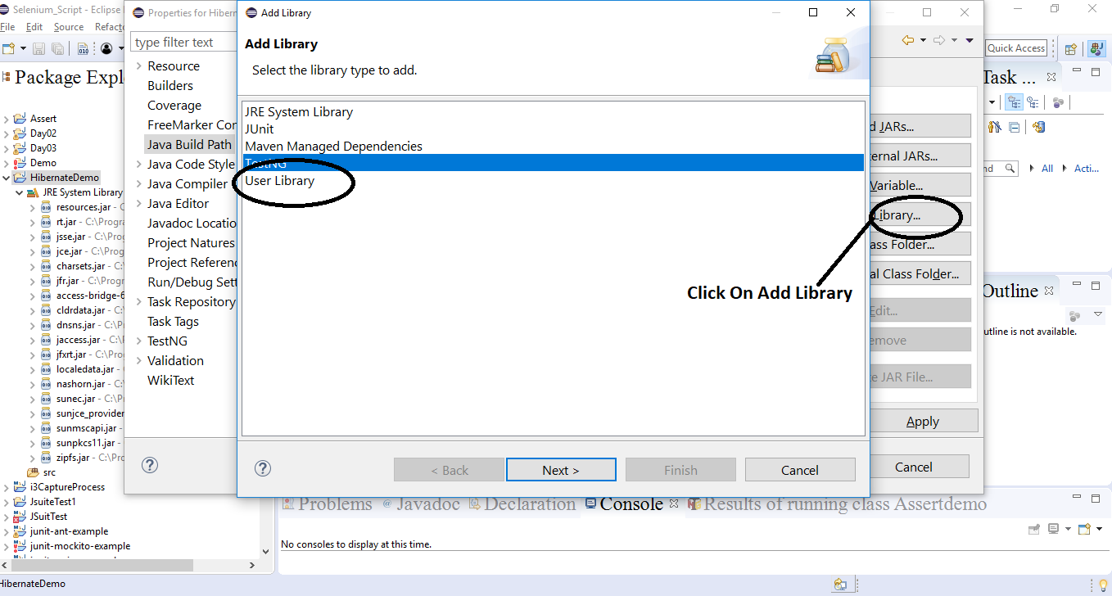
Demo: Configuration Cont..
Step :5
Click On Library and Click On User Library

Slide 21
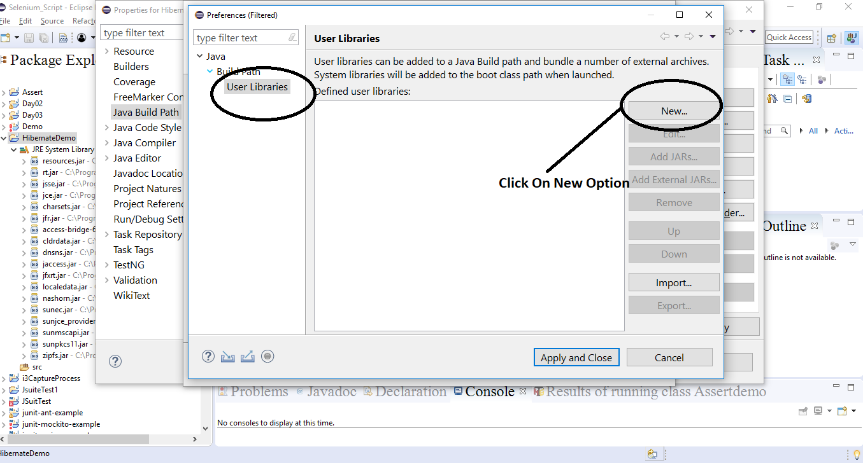
Demo: Configuration Cont..
Step :6
Click On User Library And Click On New Button

Slide 22
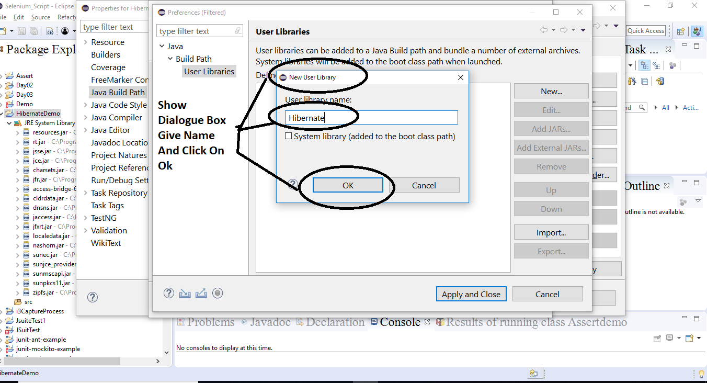
Demo: Configuration Cont..
Step :7
Give Proper Name Of User Library and Click On Ok

Slide 23
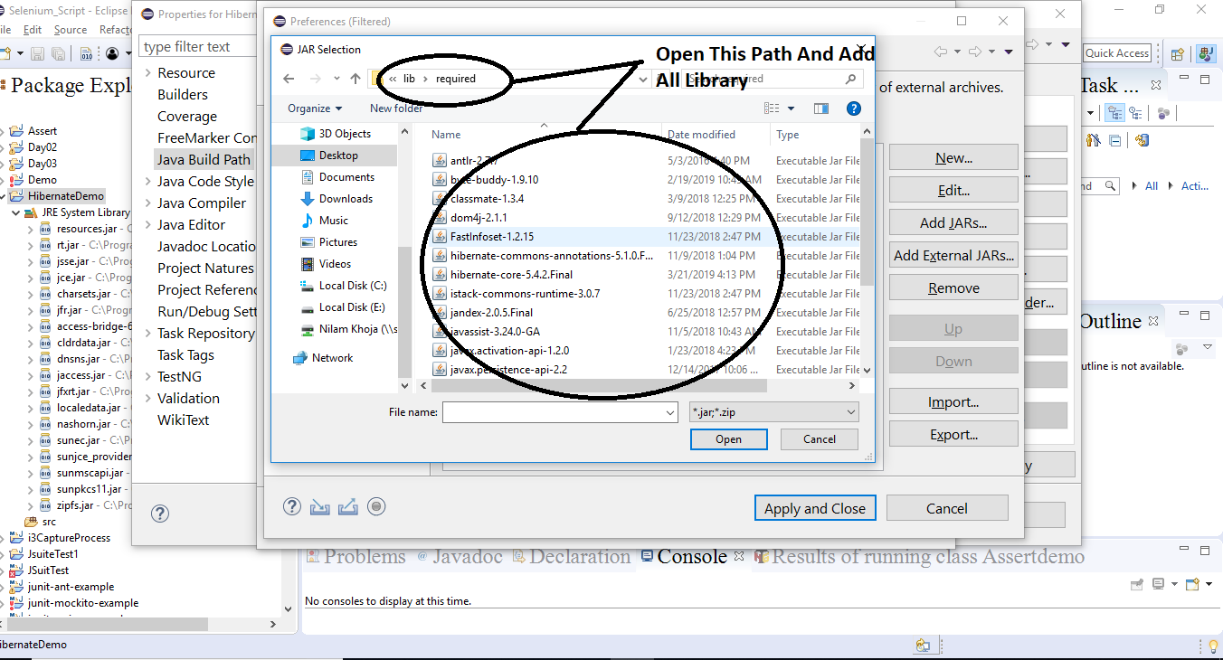
Demo: Configuration Cont..
Step :8
Select All JAR Files Of Repository From Repository Location

Slide 24
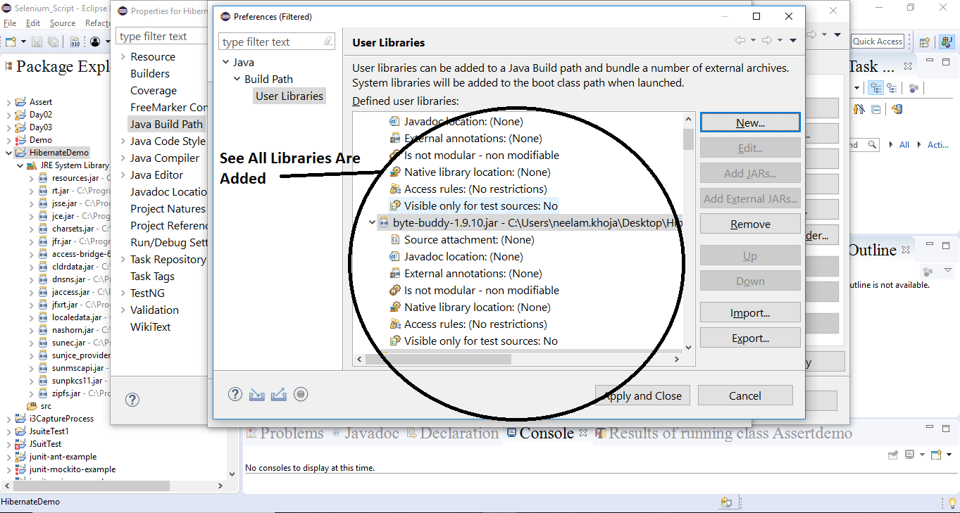
Demo: Configuration Cont..
Step :9
Open All JAR Files and Apply in Your Project

Slide 25
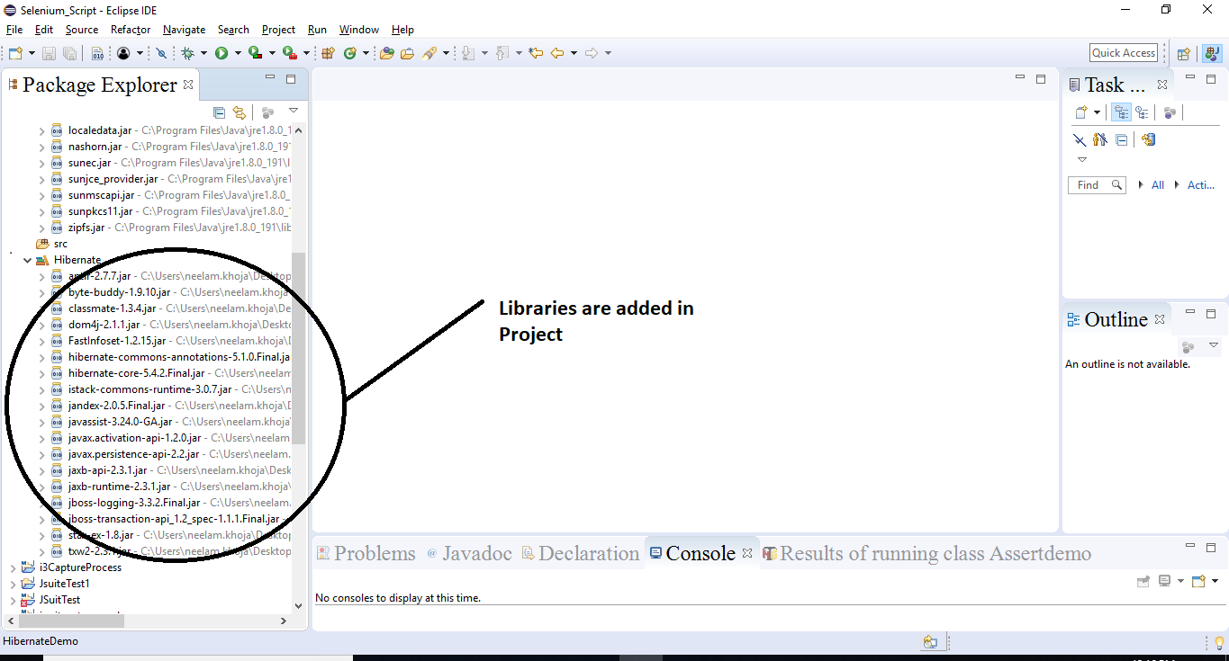
Demo: Configuration Cont..
Step :10
Now You Can See Updated Your Project Structure Added With Hibernate JAR

Slide 26
Cont..
Duration:10 Mins
Step:1:Include Database Driver In Project
Download MySQL Database and Installing MYSQL Database.
My SQL Provide Graphical User Interface For Database.
Two Ways To Install My SQL:
MySQL Database From Website
Use XAMP SERVER.
Step:2: Easy Way To Use XAMPP For MYSQL Databse.

Slide 27
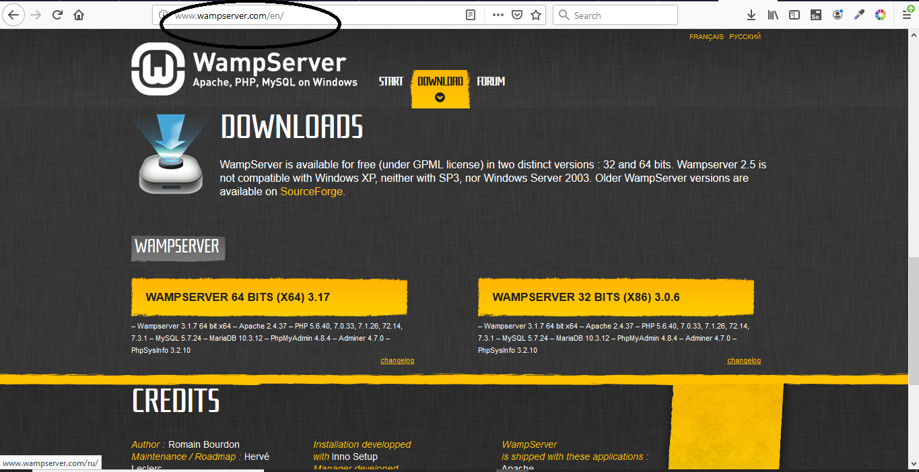
Including MYSQL Duration: 15 min
Installing MYSQL Using WAMP
Step 1:Go To http://www.wampserver.com/en/ site.

Slide 28
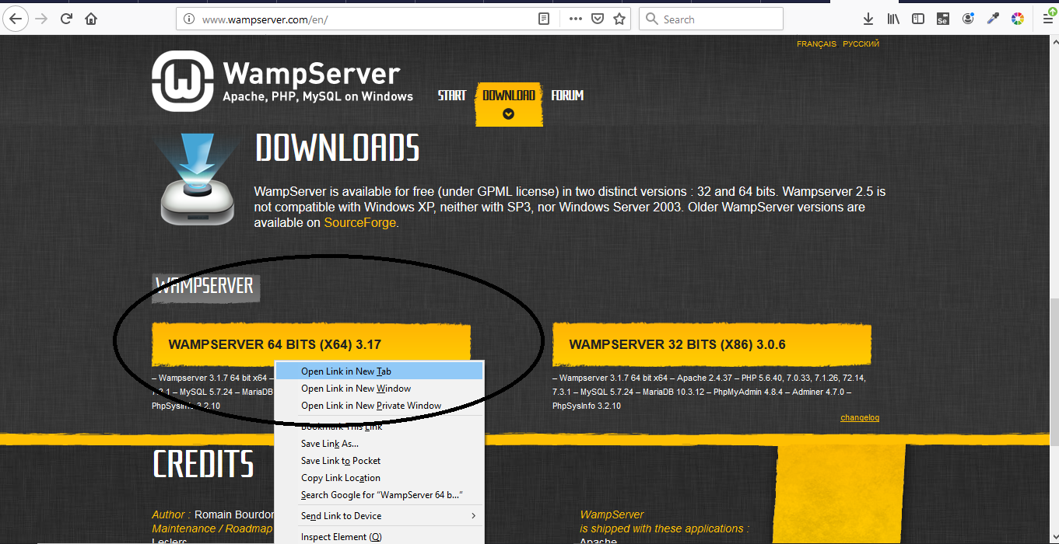
Cont..
Step : 2
Click On WAMPSERVER.

Slide 29
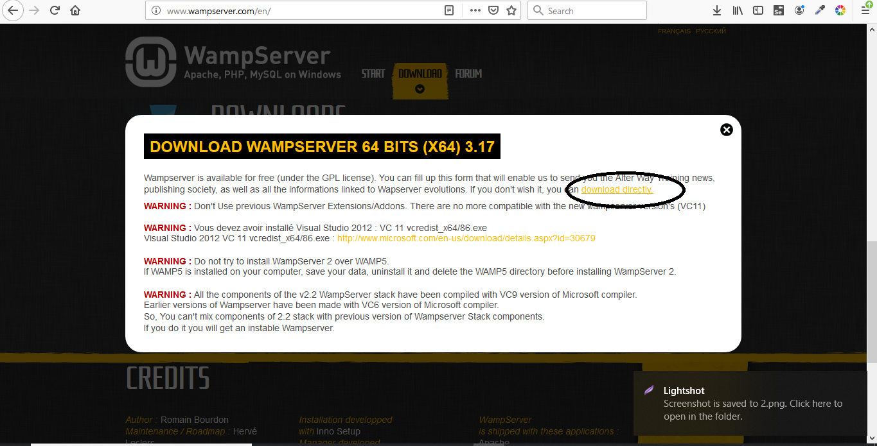
Cont..
Step : 3
You Can See This Dialogue And Click On Download Directly

Slide 30
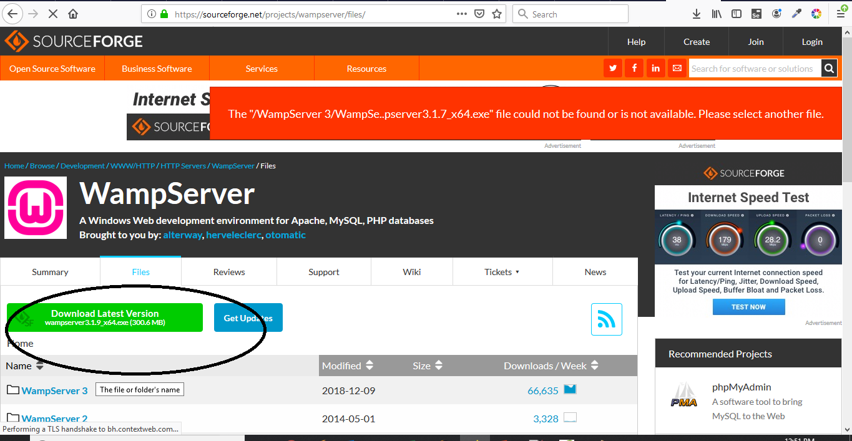
Cont..
Step : 4
Download Latest Version

Slide 31
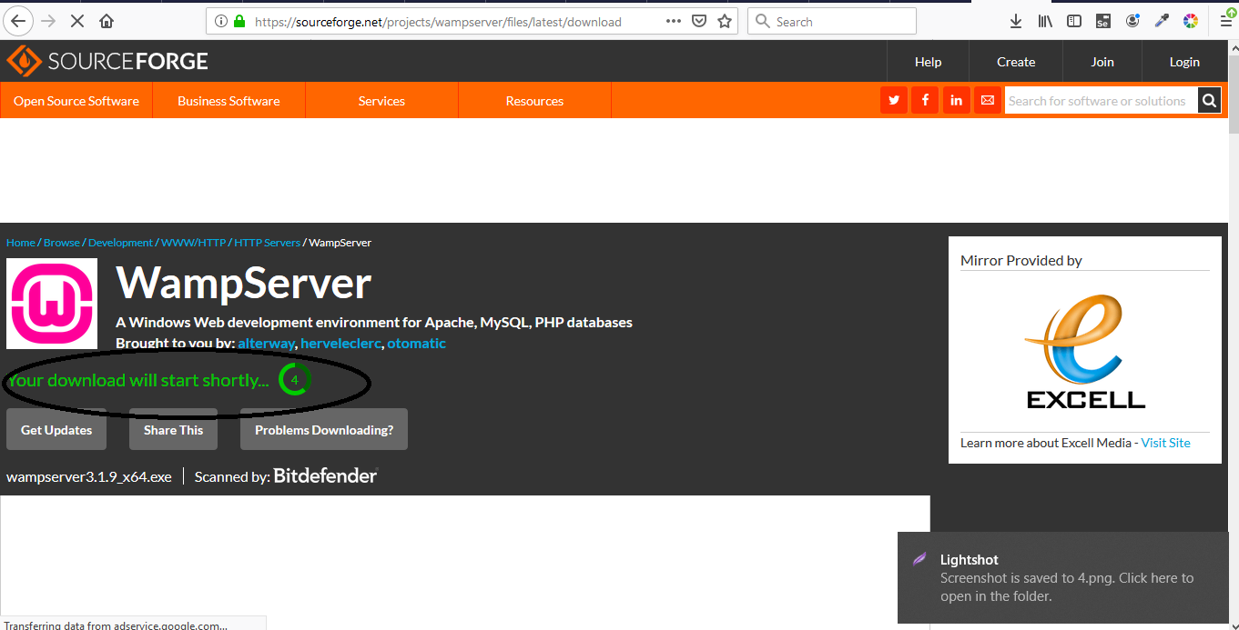
Cont..
Step : 6
Download Start In Few Seconds

Slide 32
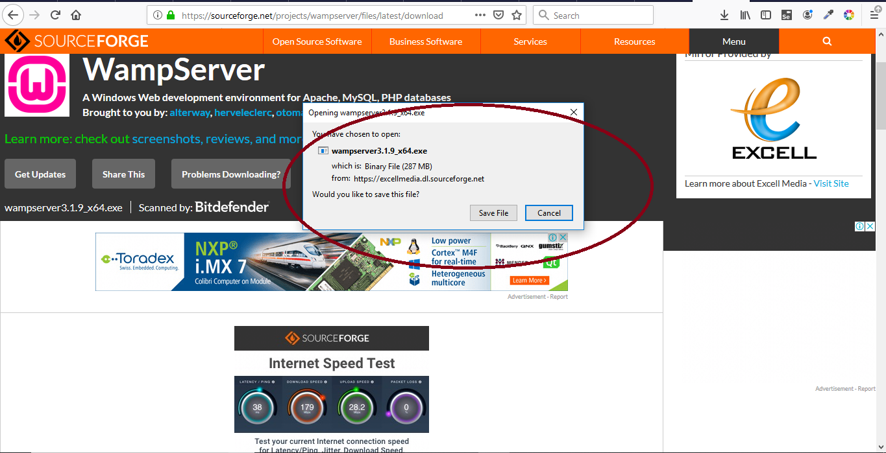
Cont..
Step : 7
Save Downloaded File In Particular Location

Slide 33
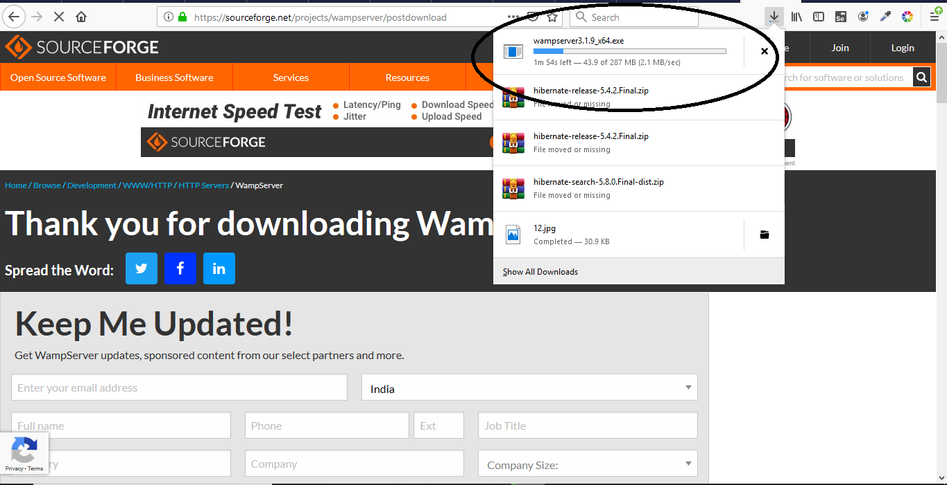
Cont..
Step : 8
You Can See Downloaded Process

Slide 34
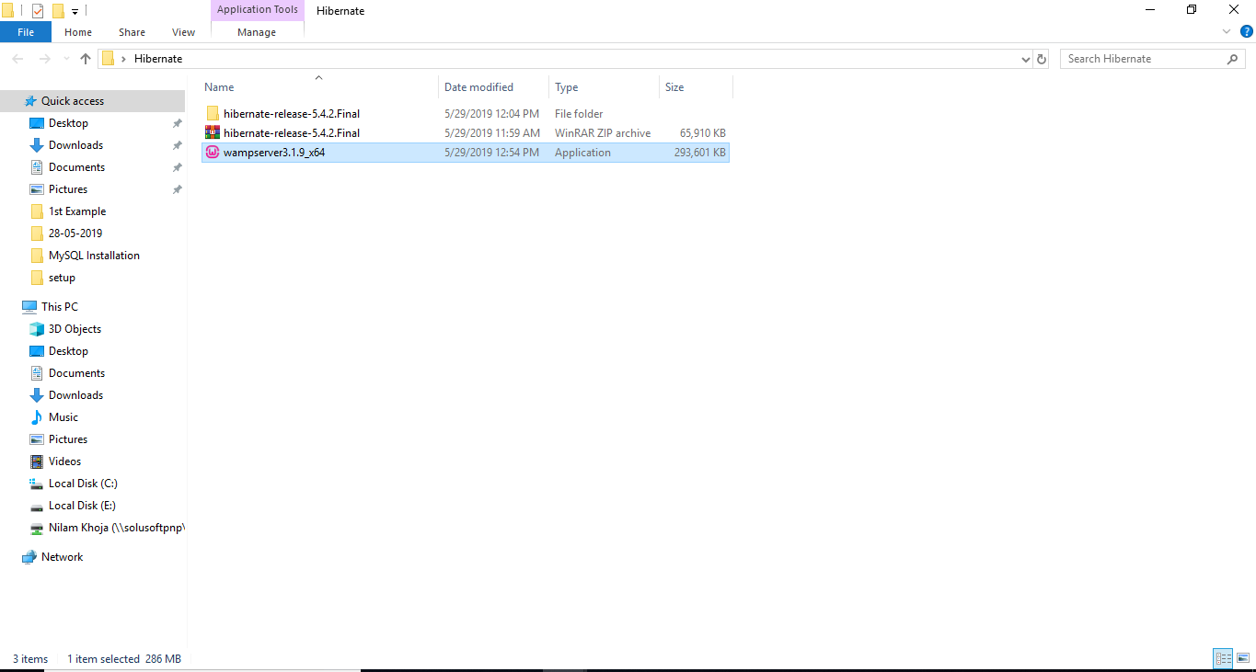
Cont..
Step : 9
Open Location In Your System Where Wamp Download

Slide 35
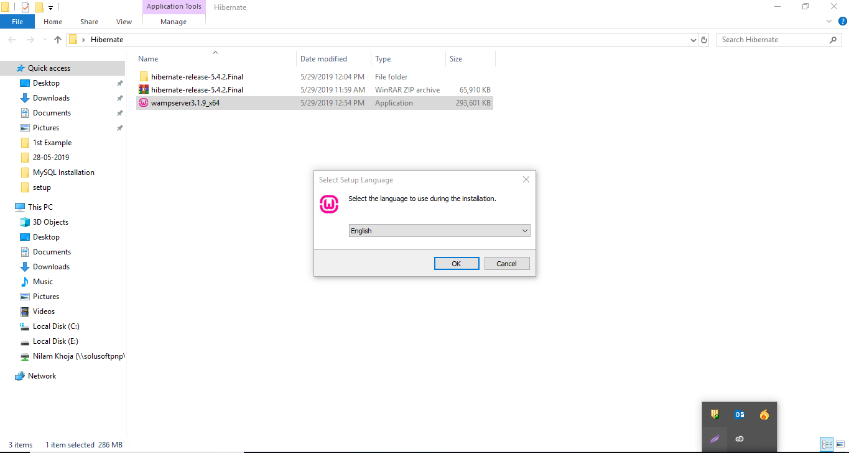
Cont..
Step : 10
Double Click On Software. It Show Following Dialogue

Slide 36
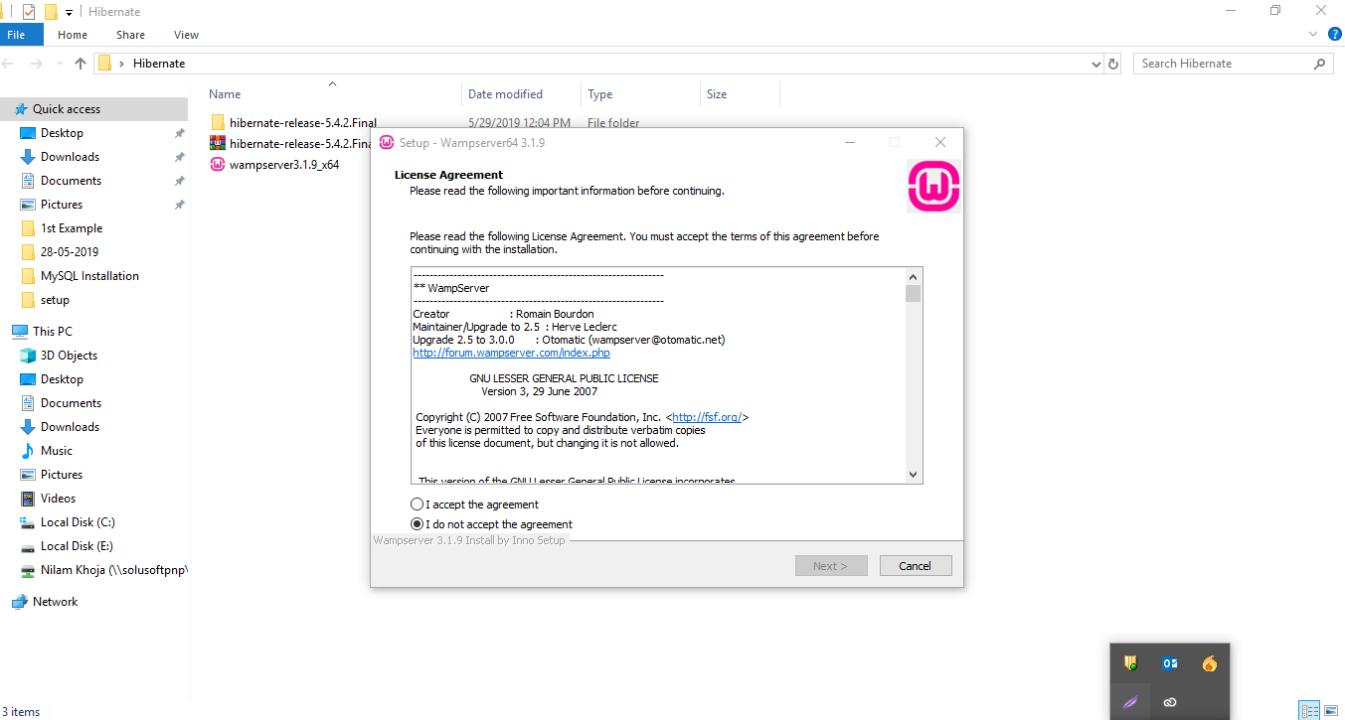
Cont..
Step : 11
Click On OK Button And Start Installing

Slide 37
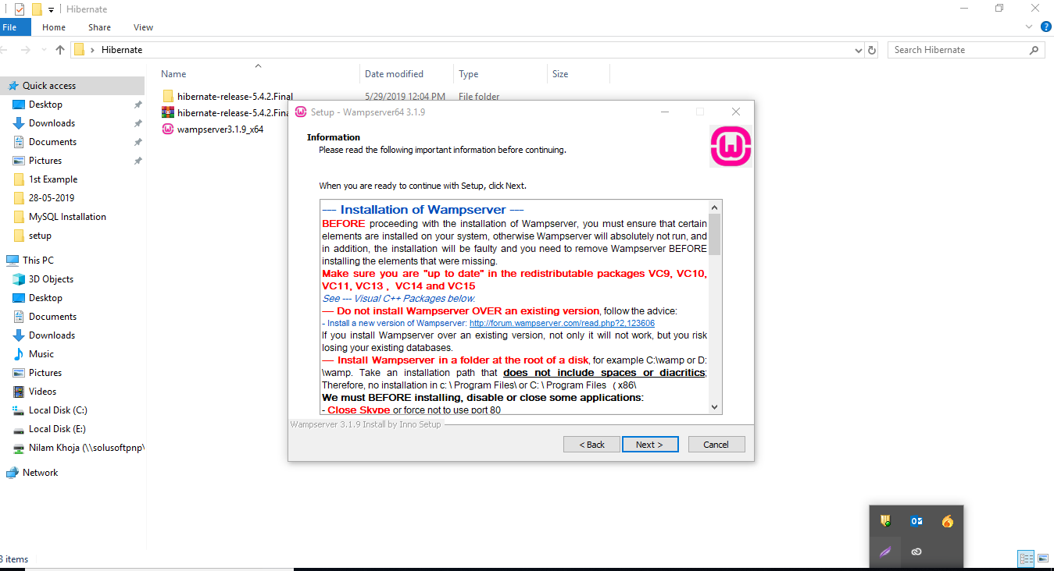
Cont..
Step : 12
Accept License Agreement And Click On Next Button

Slide 38
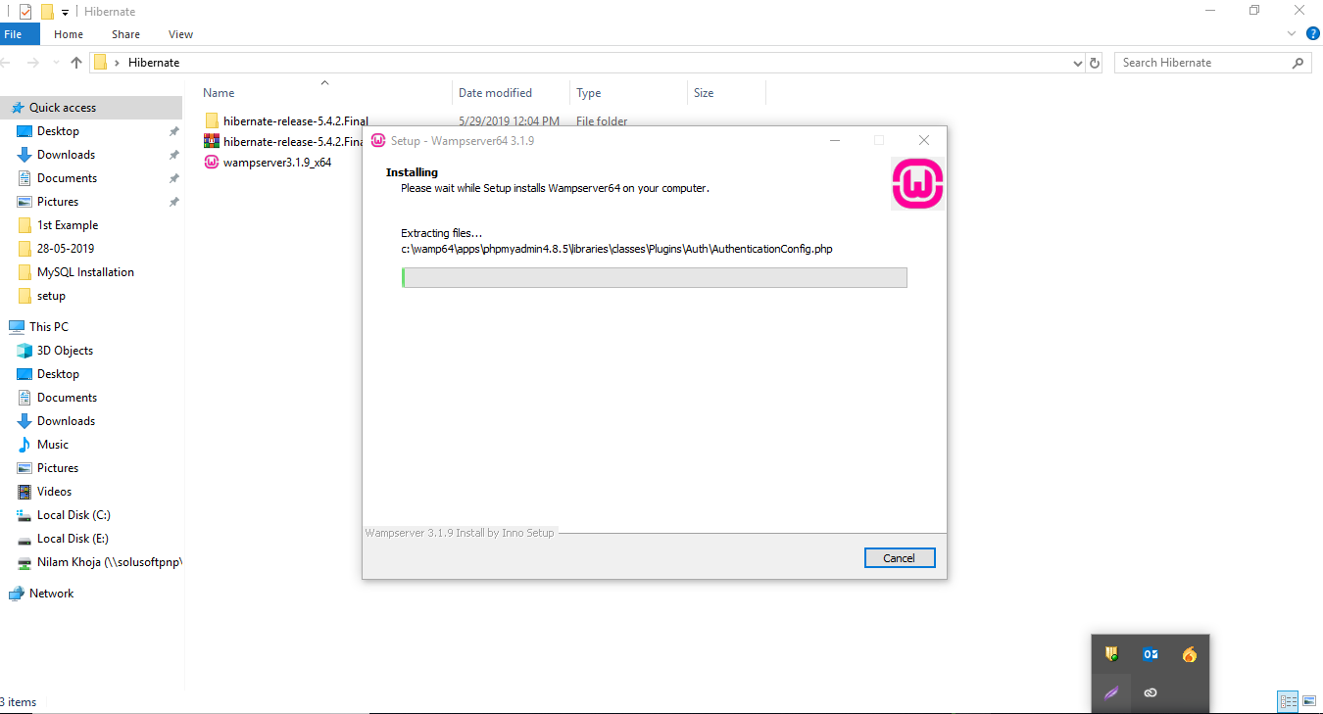
Cont..
Step : 13
Installation processing

Slide 39
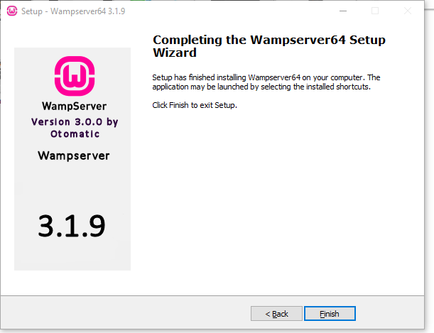
Cont..
Step : 14
Click On Finish Button When Installation Complete

Slide 40
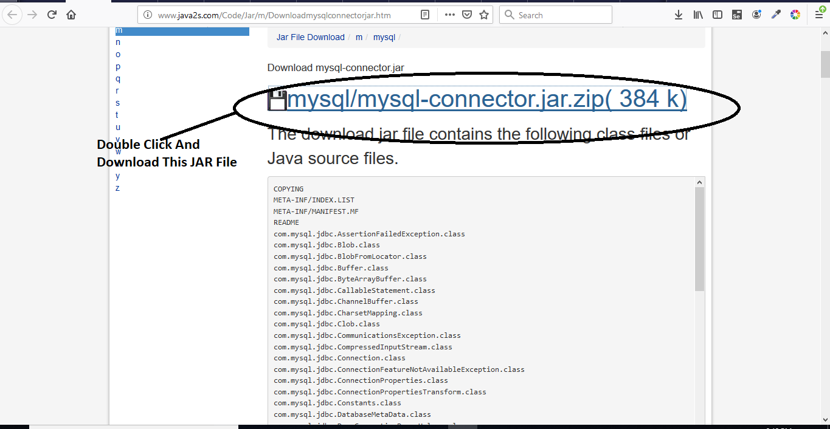
Cont..
Step : 15 Add MySQLConnector JAR File
After Installation Of WAMMP And MySQL Download MySQLConnector Jar File.

Slide 41
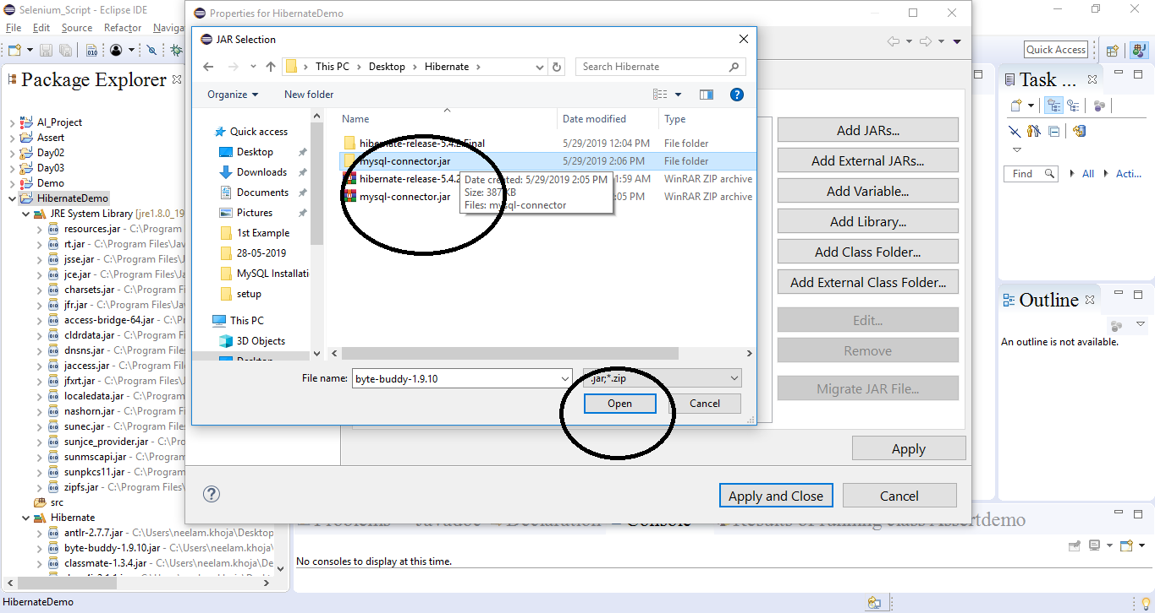
Cont..
Step : 16
Right Click On Project and MY SQL CONNECTOR Jar File From Build Path

Slide 42
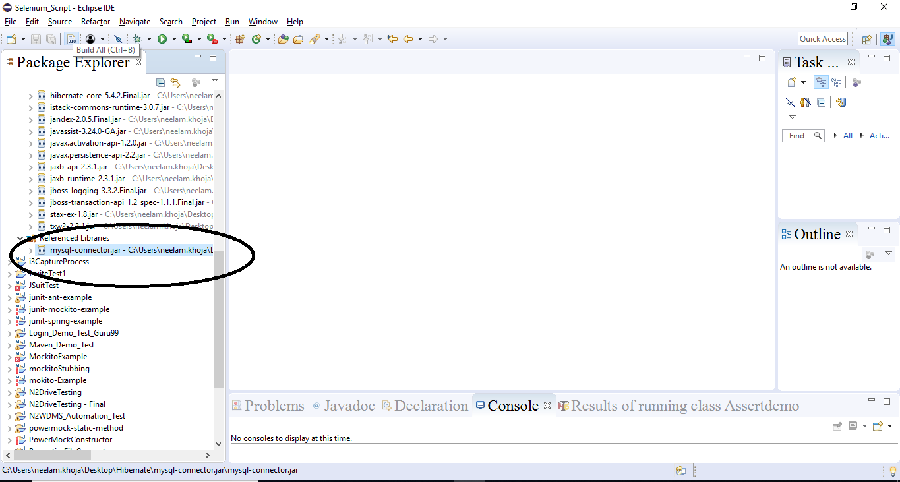
Cont..
Step : 17
Jar File Is Added in Project Referenced Library Folder

Slide 43
Session
Session is the main runtime interface between a Java application and Hibernate and the central API class abstracting the notion of a persistence service.
The lifecycle of a Session is bounded by the beginning and end of a logical transaction.
The main function of the Session is to furnish create, read and delete operations for instances of mapped entity classes. Instances may exist in one of three state
transient: never persistent, not associated with any Session
An object which is not defined with session is called Transient Object State.
No Any Row defined in database is Transient Object State
It is Garbage Collector No Other Object Refer To It.
It is created with new() Operator.
When Object defined in Transient Object State there is no defined any identifier.
Example:
Employee emp = new Employee();
emp.setName("Ravi Raj");
// here emp object is in a transient state

Slide 44
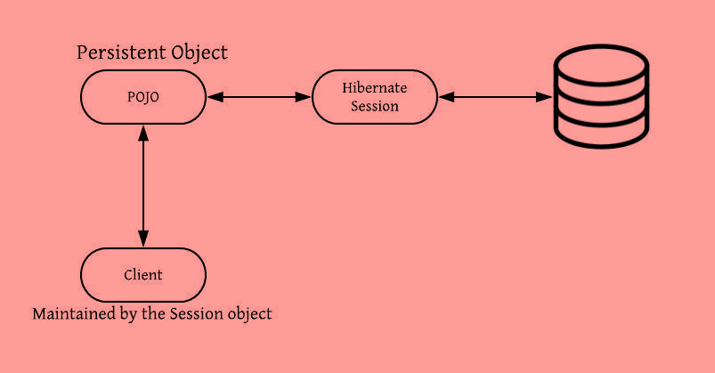
Session Cont..
Persistent Object State:
When` Object is defined with Session called Persistent Object State.
It represent all row of database with their identifier.
Long id = (Long) session.save(emp);
// emp object is now in a persistent state

Slide 45
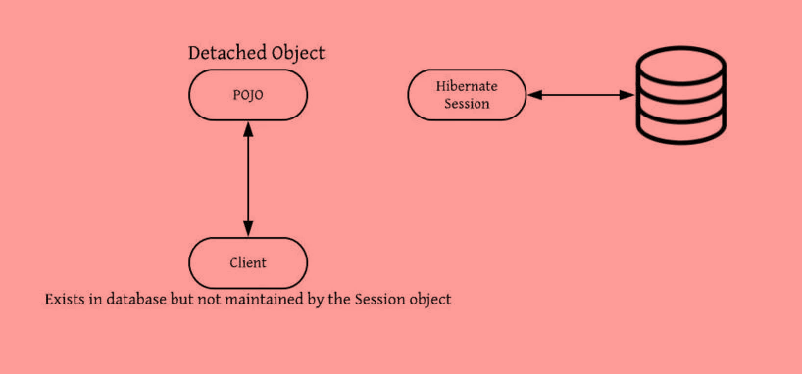
Cont..
Detached Object State:
When Object just removed from Session called Detached Object State.
When object define with this state it has also defined identifier but not perform any operation.
If any changes are made in this state it will not saved.
Example:
session.close();
//object in detached state

Slide 46
Cont..
New object created
Transient
Garbage collection
get()
load()
iterate()
find() etc
save()
saveOrUpdate()
Removed
Persistent
Garbage collection
delete()
evict()
clear()
close()
update()
merge()
saveOrUpdate()
Detached
Garbage collection

Slide 47
Demo: Session Duration 20 min
import org.hibernate.Session; import org.hibernate.Transaction; import org.hibernate.cfg.Configuration; import com.hibernate.model.Employee; public class ObjectLifecycle { public static void main(String[] args) { // 'emp' object is in 'TRANSIENT' state. Employee emp = new Employee(); emp.setName("Patrick"); emp.setDesignation("Sr. Manager"); emp.setDepartment("Human Resource"); // Creating the config instance & passing the hibernate config file. Configuration config = new Configuration(); config.configure("hibernate.cfg.xml"); | // Session object to start the db transaction. Session s = config.buildSessionFactory().openSession(); // Transaction object to begin the db transaction. Transaction t = s.beginTransaction(); // Here 'emp' object is in 'PERSISTENT' state. s.save(emp); // 'emp' object will be saved to the database. t.commit(); // Closing the session object. 'emp' object is in 'DETACHED' object. s.close(); } }

Slide 48
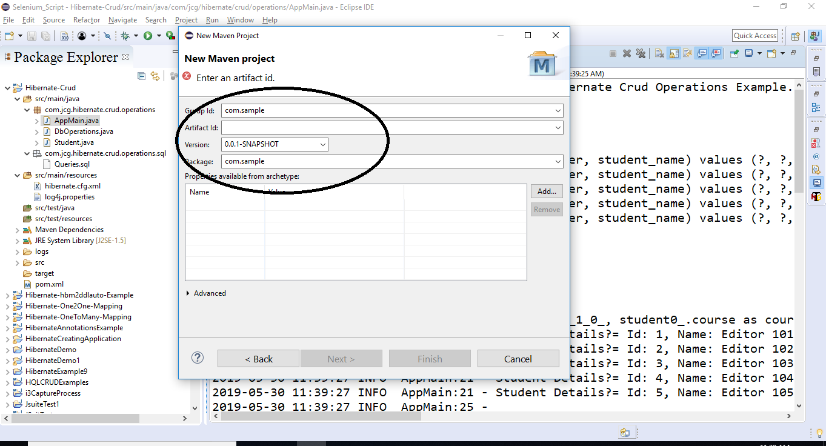
save, get, update, delete database operations using Hibernate
Demo: Session Cont..
Example
Step 1:
Create Java Project with Suitable Name

Slide 49
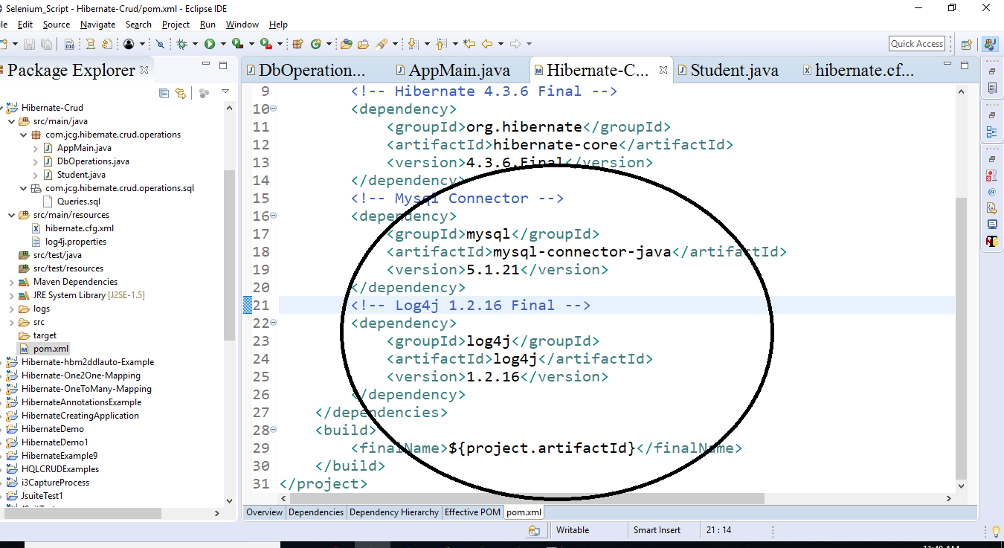
Cont..
Step 2:
Add Dependency

Slide 50
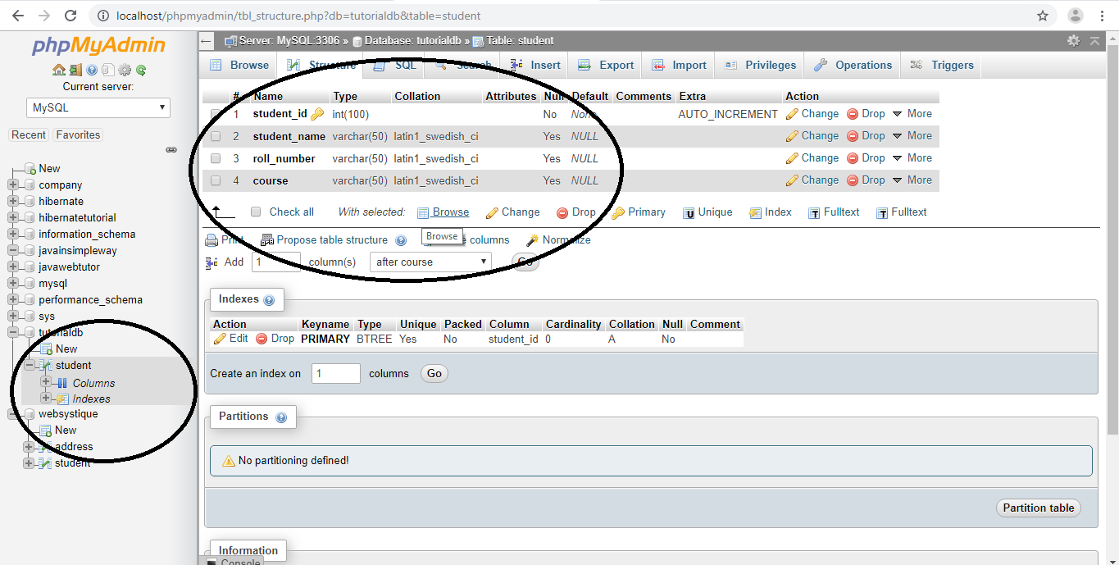
Cont..
Step 3:
Create Database

Slide 51
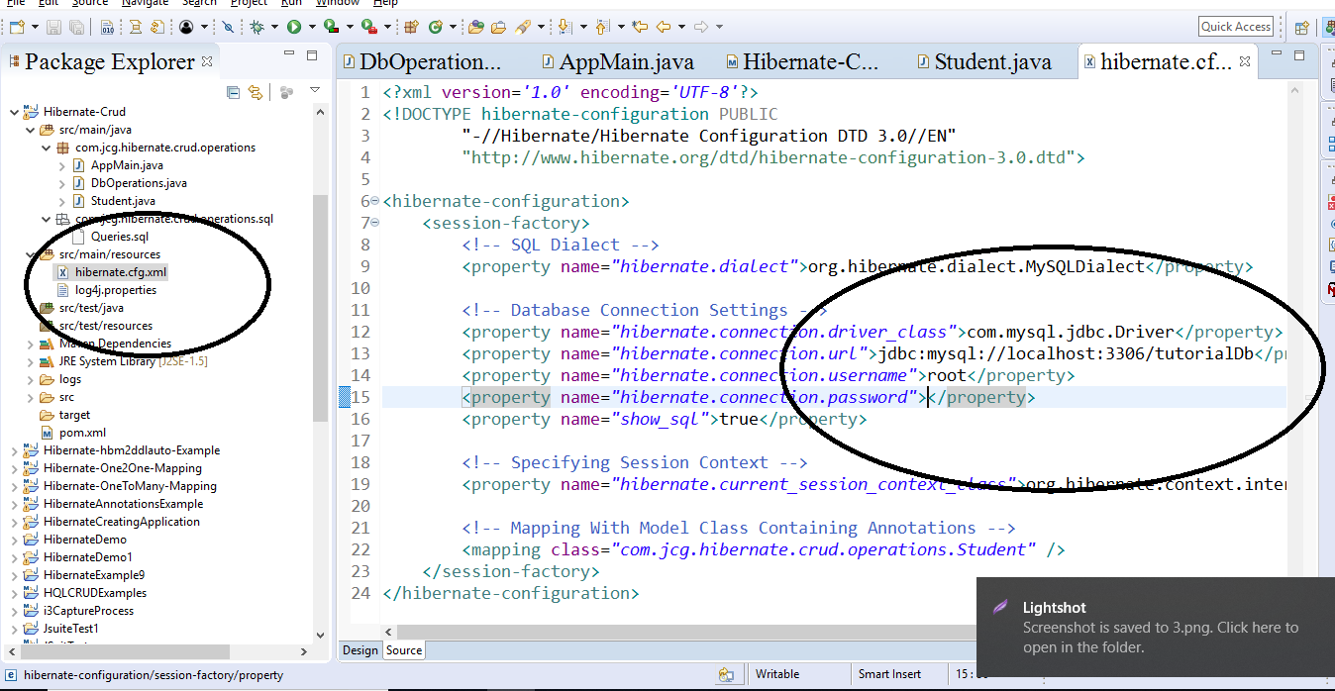
Cont..
Step 4:
Configure Database

Slide 52
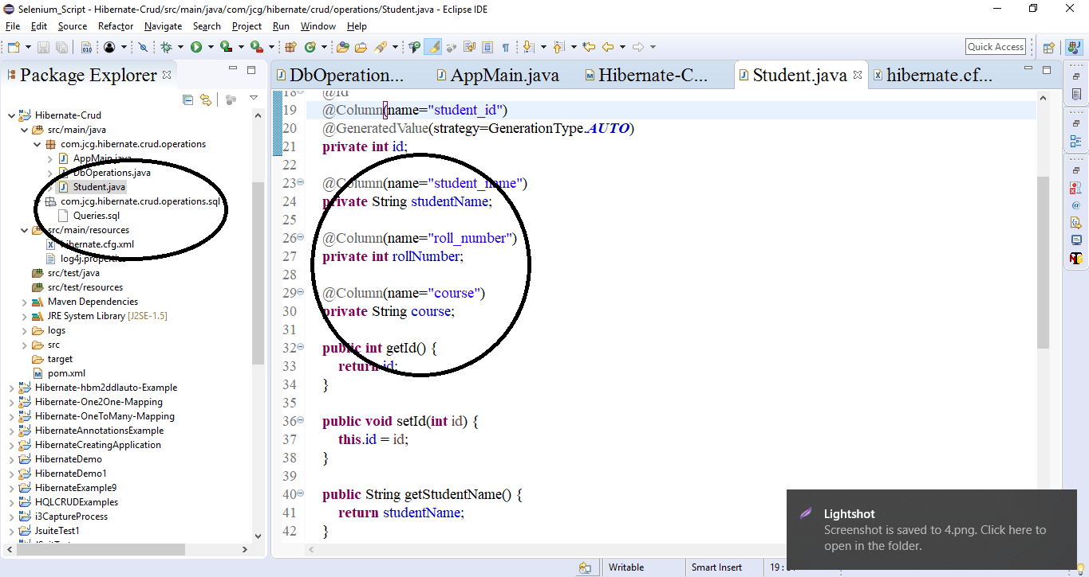
Cont..
Step 5:
Create Pojo

Slide 53
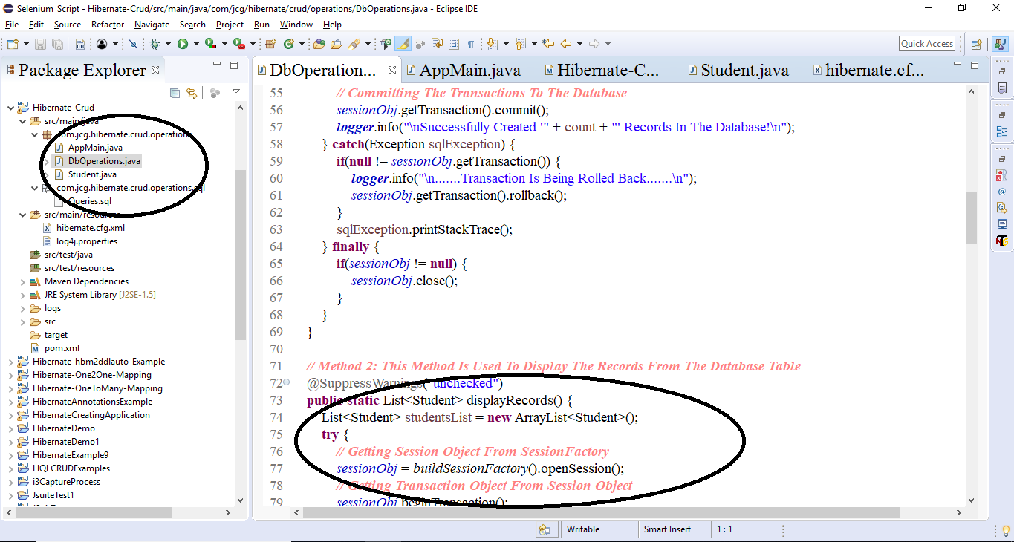
Cont..
Step 6:
Perform All DB Operation

Slide 54
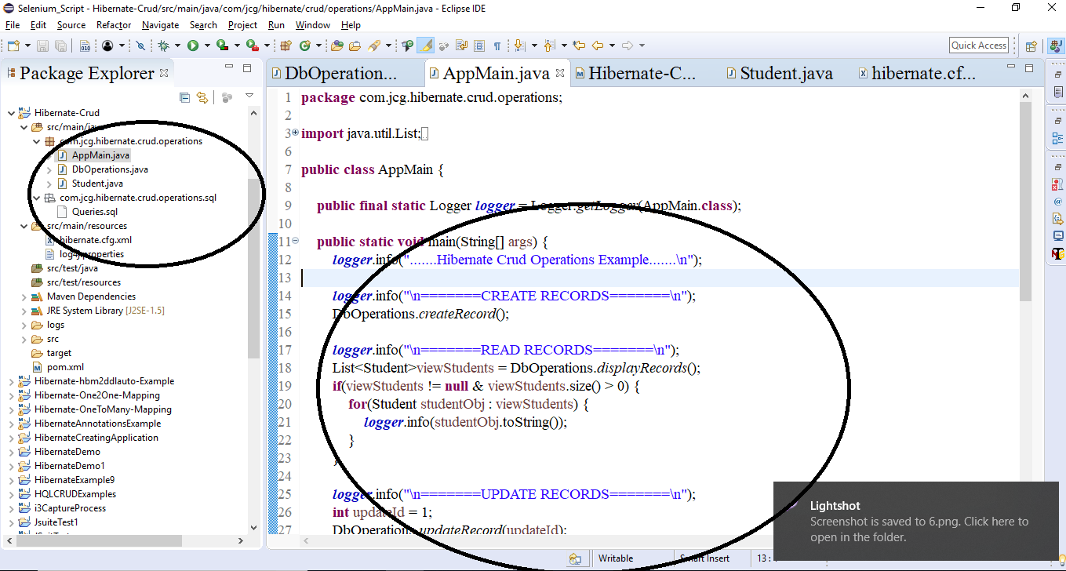
Cont..
Step 7:
Create Java File

Slide 55
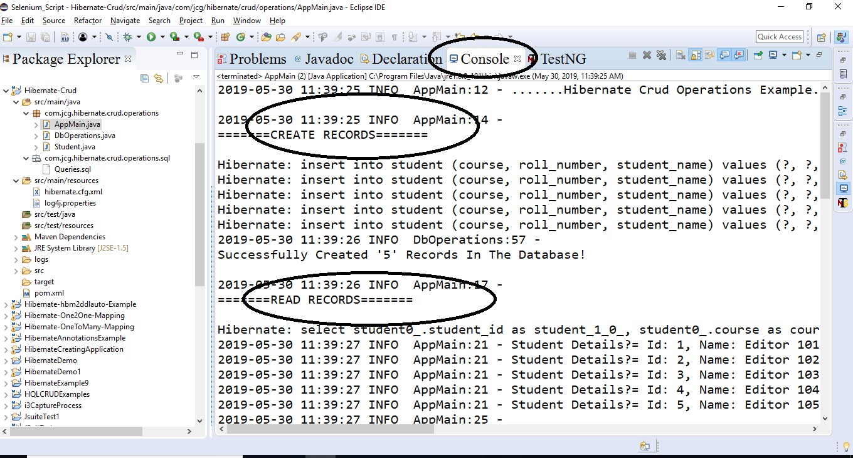
Cont..
Step 8:
Run Project

Slide 56
Cont..
hbm2ddl.auto property
Hbm2ddl.auto is a one of the Configuration Property in Hibernate.
Used to Validate and Export schemas in the database when SessionFactory Created.
Syntax:
If We Used Hbm2ddl.auto property, we must change in Hbm.Confg.file to add this property
Hbm.Conf.Xml
<hibernate-configuration>
<session-factory>
<property name="hbm2ddl.auto">value</property>
</session-factory>
</hibernate-configuration>

Slide 57
Summary
In this Module, we have learnt the following:
Overview of Hibernate
Architecture
Environment Setup
Configuration
Sessions

Slide 58

Thank You

